Slide 1
Bayesian Inference
Module 6, Lesson 3
Notes:
Welcome to lesson 3 of module 6

Slide 2
Markov Chain Methods
Shahrzad Jamshidi, PhD
Notes:
In this lesson, we will discuss Markov Chain Methods

Slide 3
Objectives
Understand the principles of Markov chain simulation.
Learn and apply the Gibbs sampler, Metropolis algorithm, and Metropolis-Hasting algorithm.
Notes:
By the end of this lesson, you will
Understand the principles of Markov chain simulation.
Learn and apply the Gibbs sampler, Metropolis algorithm, and Metropolis-Hasting algorithm.

Slide 4
课程目标
理解马尔可夫链模拟的基本原理。
学会并应用三种经典算法：
Gibbs 采样器
Metropolis 算法
Metropolis–Hastings 算法
基础回顾
马尔可夫链 (Markov Chain)：下一步只依赖于当前状态，而与过去无关。
马尔可夫链蒙特卡罗 (MCMC)：构造一个以目标分布（如后验分布）为平稳分布的马尔可夫链，通过长时间模拟来近似目标分布。
Notes:
Topics to review for this lesson include
Matrices
Monte carlo simulation

Slide 5
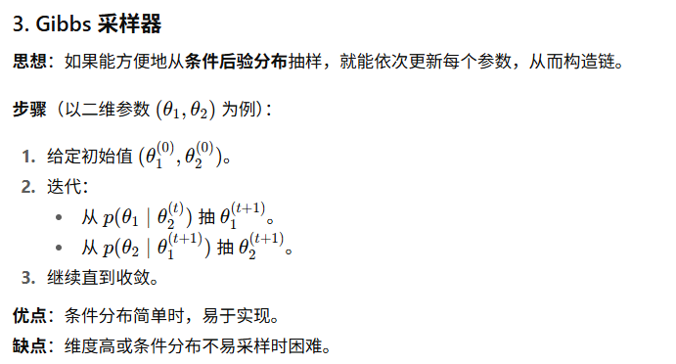
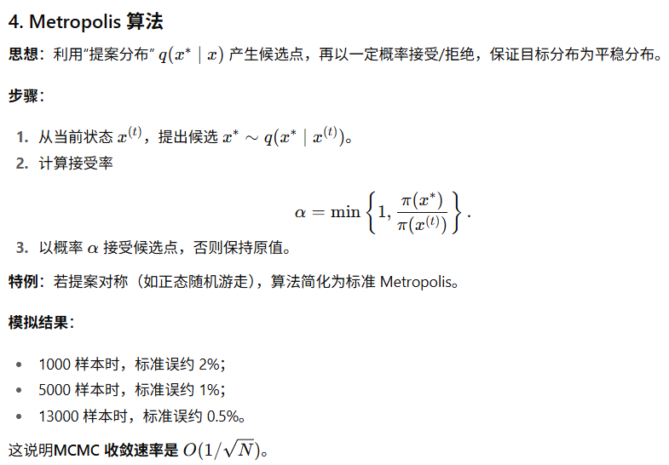
课程总结
Notes:
Topics to review for this lesson include
Matrices
Monte carlo simulation

Slide 6
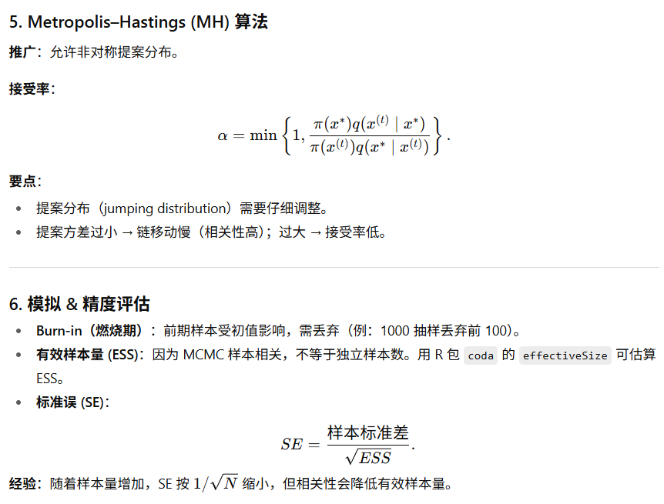
课程总结
Notes:
Topics to review for this lesson include
Matrices
Monte carlo simulation

Slide 7

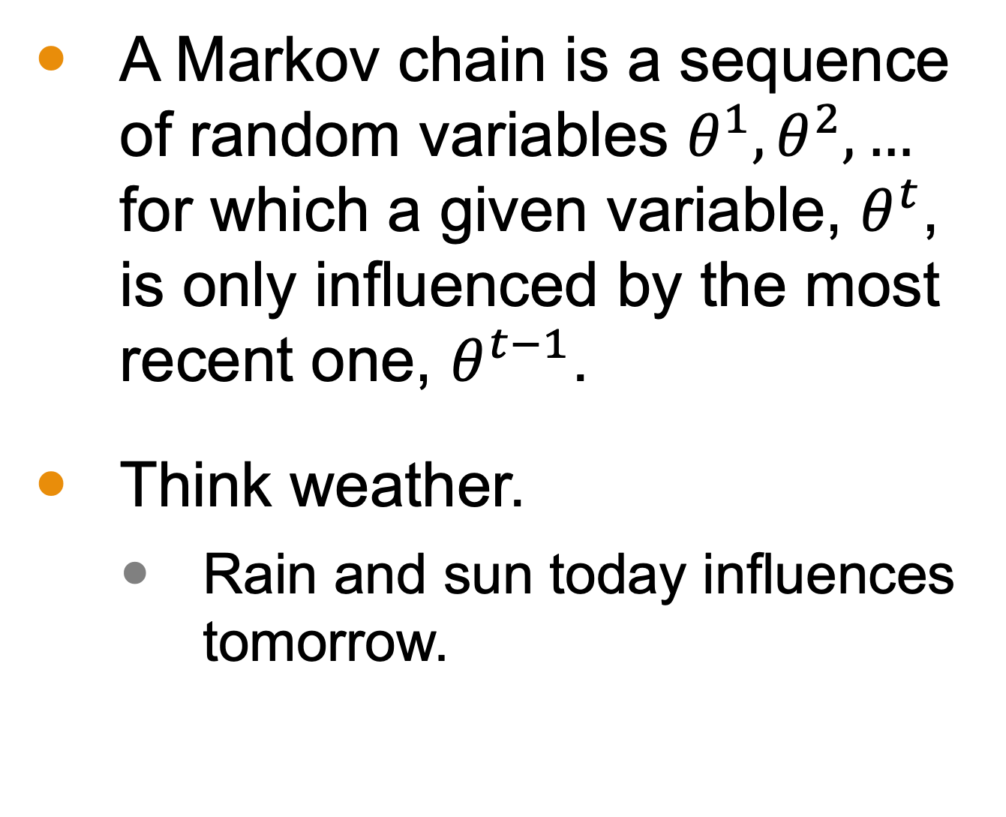
Markov Chains
A Markov chain is a sequence of random variables $θ^{1},θ^{2},…$ for which a given variable, $θ^{t}$, is only influenced by the most recent one, $θ^{t−1}$.
Think weather.
Rain and sun today influences tomorrow.
Notes:
A Markov chain is a sequence of random variables where each variable is influenced only by the most recent one. In other words, it is a memory-less process.
Think of weather forecasting: today’s weather influences tomorrow’s weather.

Slide 8
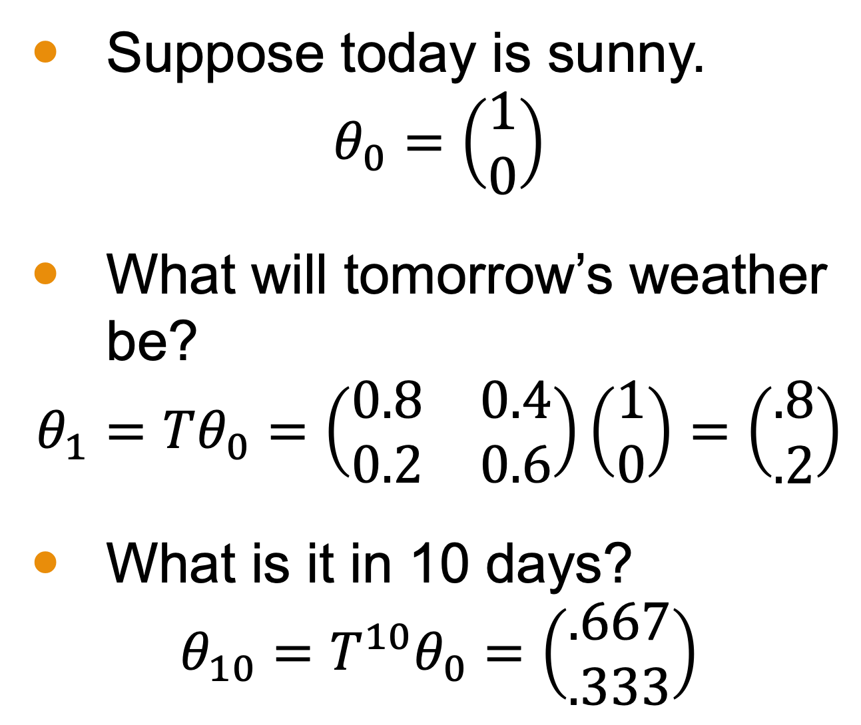
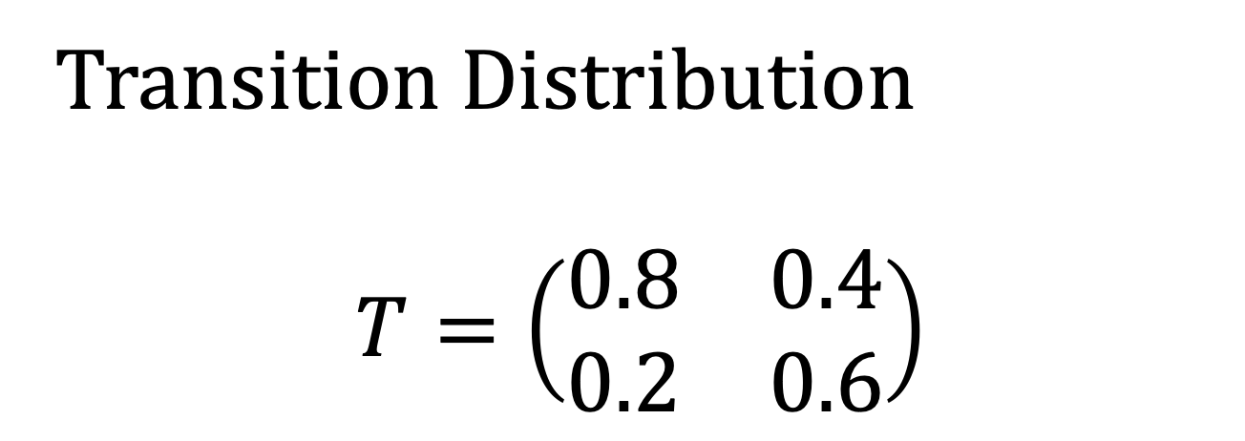
Markov Chain Example
Suppose today is sunny.
$$θ_{0}=\left(\begin{matrix}1 \\ 0\end{matrix}\right)$$
What will tomorrow’s weather be?
$$θ_{1}=Tθ_{0}=\left(\begin{matrix}0.8 & 0.4 \\ 0.2 & 0.6\end{matrix}\right)\left(\begin{matrix}1 \\ 0\end{matrix}\right)=\left(\begin{matrix}.8 \\ .2\end{matrix}\right)$$
What is it in 10 days?
$$θ_{10}=T^{10}θ_{0}=\left(\begin{matrix}.667 \\ .333\end{matrix}\right)$$
Today | Tomorrow | Probability
Sunny | Sunny | 80%
Sunny | Rainy | 20%
Rainy | Sunny | 40%
Rainy | Rainy | 60%
Transition Distribution
$$T=\left(\begin{matrix}0.8 & 0.4 \\ 0.2 & 0.6\end{matrix}\right)$$

Slide 9
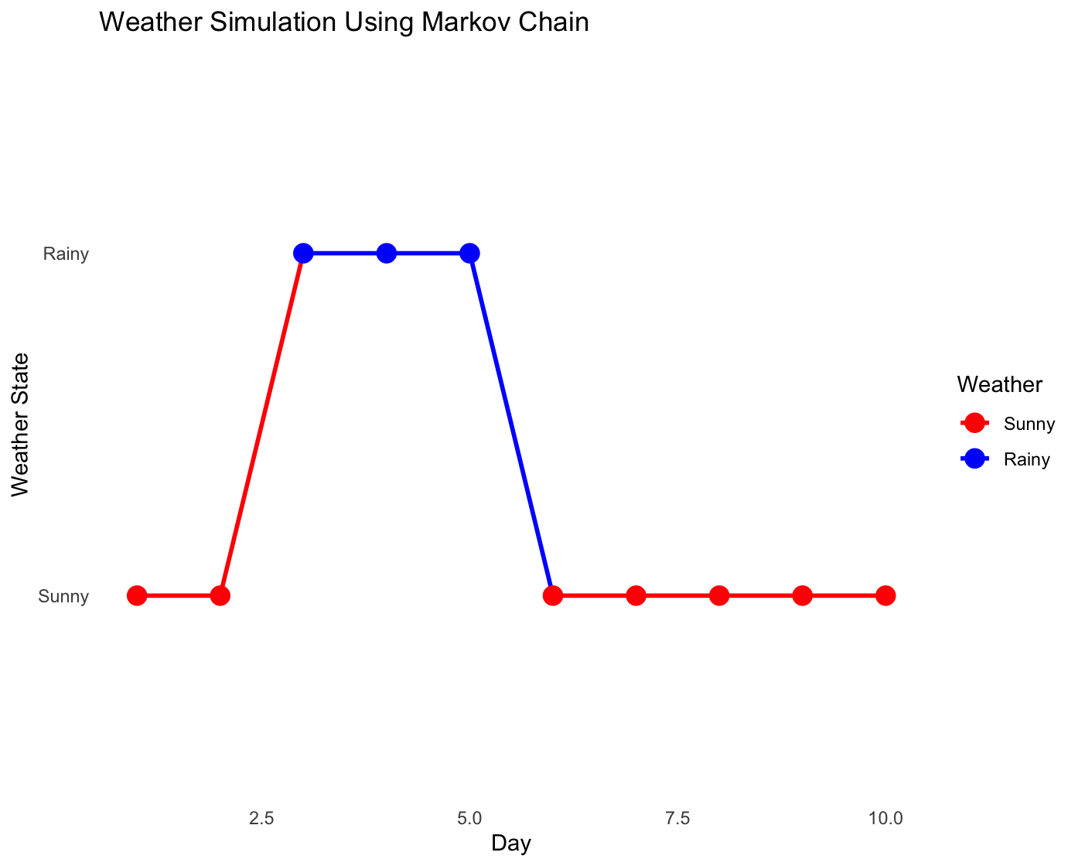
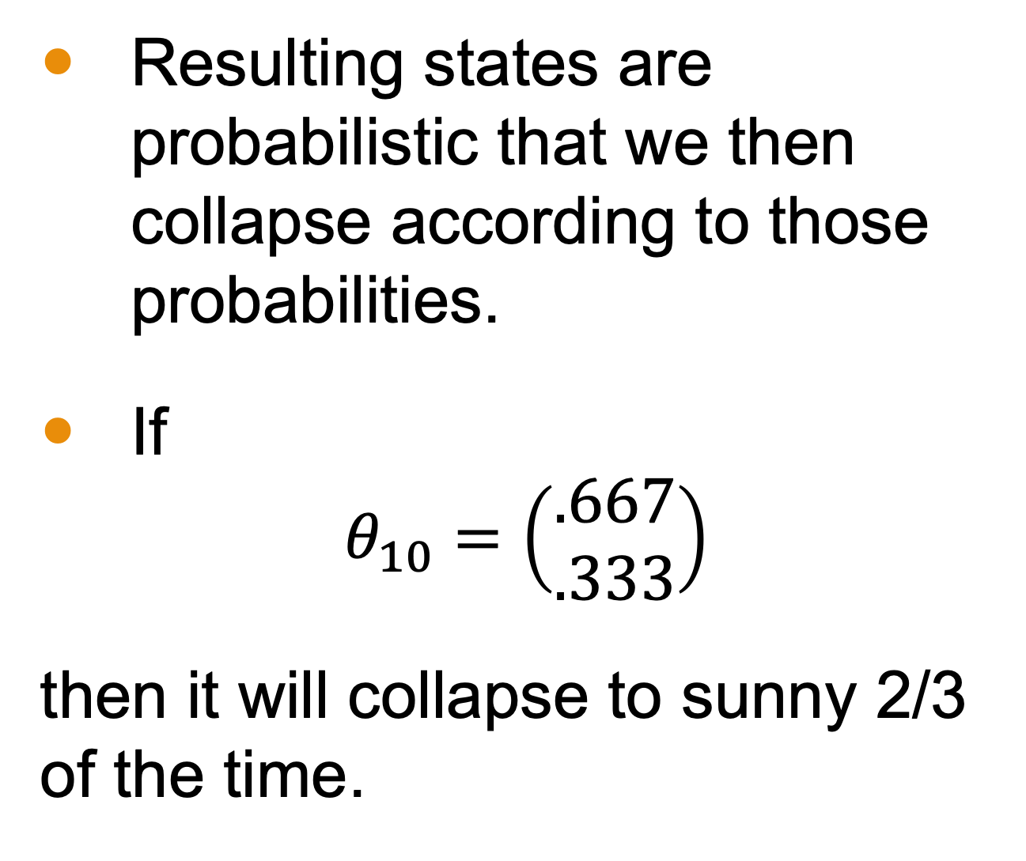
Markov Chain Example
Resulting states are probabilistic that we then collapse according to those probabilities.
If
$$θ_{10}=\left(\begin{matrix}.667 \\ .333\end{matrix}\right)$$
then it will collapse to sunny 2/3 of the time.

Slide 10
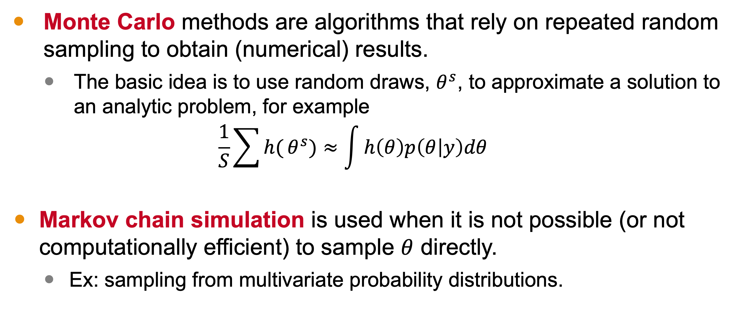
Markov Chain Monte Carlo (MCMC)
Monte Carlo methods are algorithms that rely on repeated random sampling to obtain (numerical) results.
The basic idea is to use random draws, $θ^{s}$, to approximate a solution to an analytic problem, for example
$$\frac{1}{S}\sum{h(}θ^{s})≈\int{h\left(θ\right)p\left(θ | y\right)dθ}$$
Markov chain simulation is used when it is not possible (or not computationally efficient) to sample $θ$ directly.
Ex: sampling from multivariate probability distributions.

Slide 11
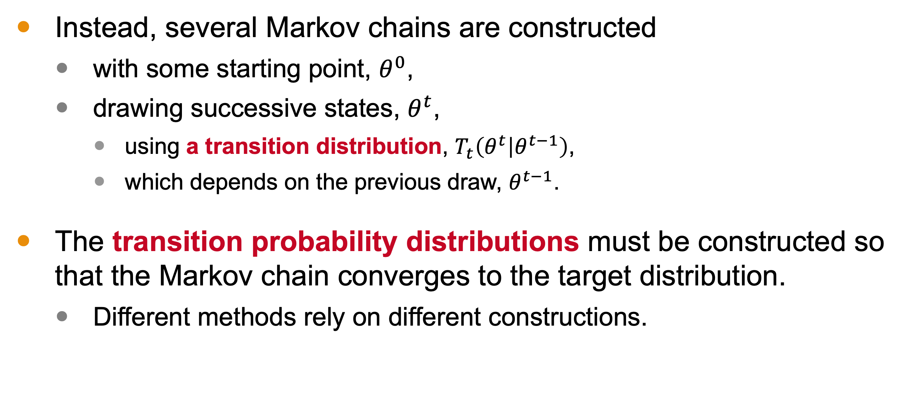
Markov Chain Monte Carlo (MCMC)
Instead, several Markov chains are constructed
with some starting point, $θ^{0}$,
drawing successive states, $θ^{t}$,
using a transition distribution, $T_{t}\left(θ^{t} | θ^{t−1}\right)$,
which depends on the previous draw, $θ^{t−1}$.
The transition probability distributions must be constructed so that the Markov chain converges to the target distribution.
Different methods rely on different constructions.

Slide 12
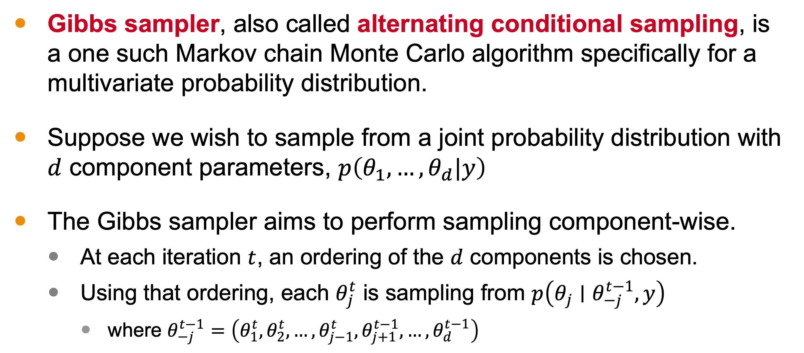
Gibbs Sampler
Gibbs sampler, also called alternating conditional sampling, is a one such Markov chain Monte Carlo algorithm specifically for a multivariate probability distribution.
Suppose we wish to sample from a joint probability distribution with $d$ component parameters, $p\left(θ_{1},…,θ_{d}|y\right)$
The Gibbs sampler aims to perform sampling component-wise.
At each iteration $t$, an ordering of the $d$ components is chosen.
Using that ordering, each $θ_{j}^{t}$ is sampling from $p\left(θ_{j}∣θ_{−j}^{t−1},y\right)$
where $θ_{−j}^{t−1}=\left(θ_{1}^{t},θ_{2}^{t},…,θ_{j−1}^{t},θ_{j+1}^{t−1},…,θ_{d}^{t−1}\right)$
Notes:
Gibbs sampler, which is also called alternating conditional sampling, is one such Markov chain Monte Carlo algorithm, and it’s used specifically for multivariate distributions, which are notoriously hard to sample from—as we saw in Module 5.
Suppose we wish to sample from a joint probability distribution with $d$ component parameters, $p\left(θ_{1},…,θ_{d}|y\right)$
Each iteration of the Gibbs sampler cycles through the d parameter components
At each iteration $t$, an ordering of the $d$ components is chosen and,
according to that ordering, each $θ_{j}^{t}$ is sampled from the conditional distribution
given all the other components $θ_{−j}^{t−1}=\left(θ_{1}^{t},θ_{2}^{t},…,θ_{j−1}^{t},θ_{j+1}^{t−1},…,θ_{d}^{t−1}\right)$

Slide 13
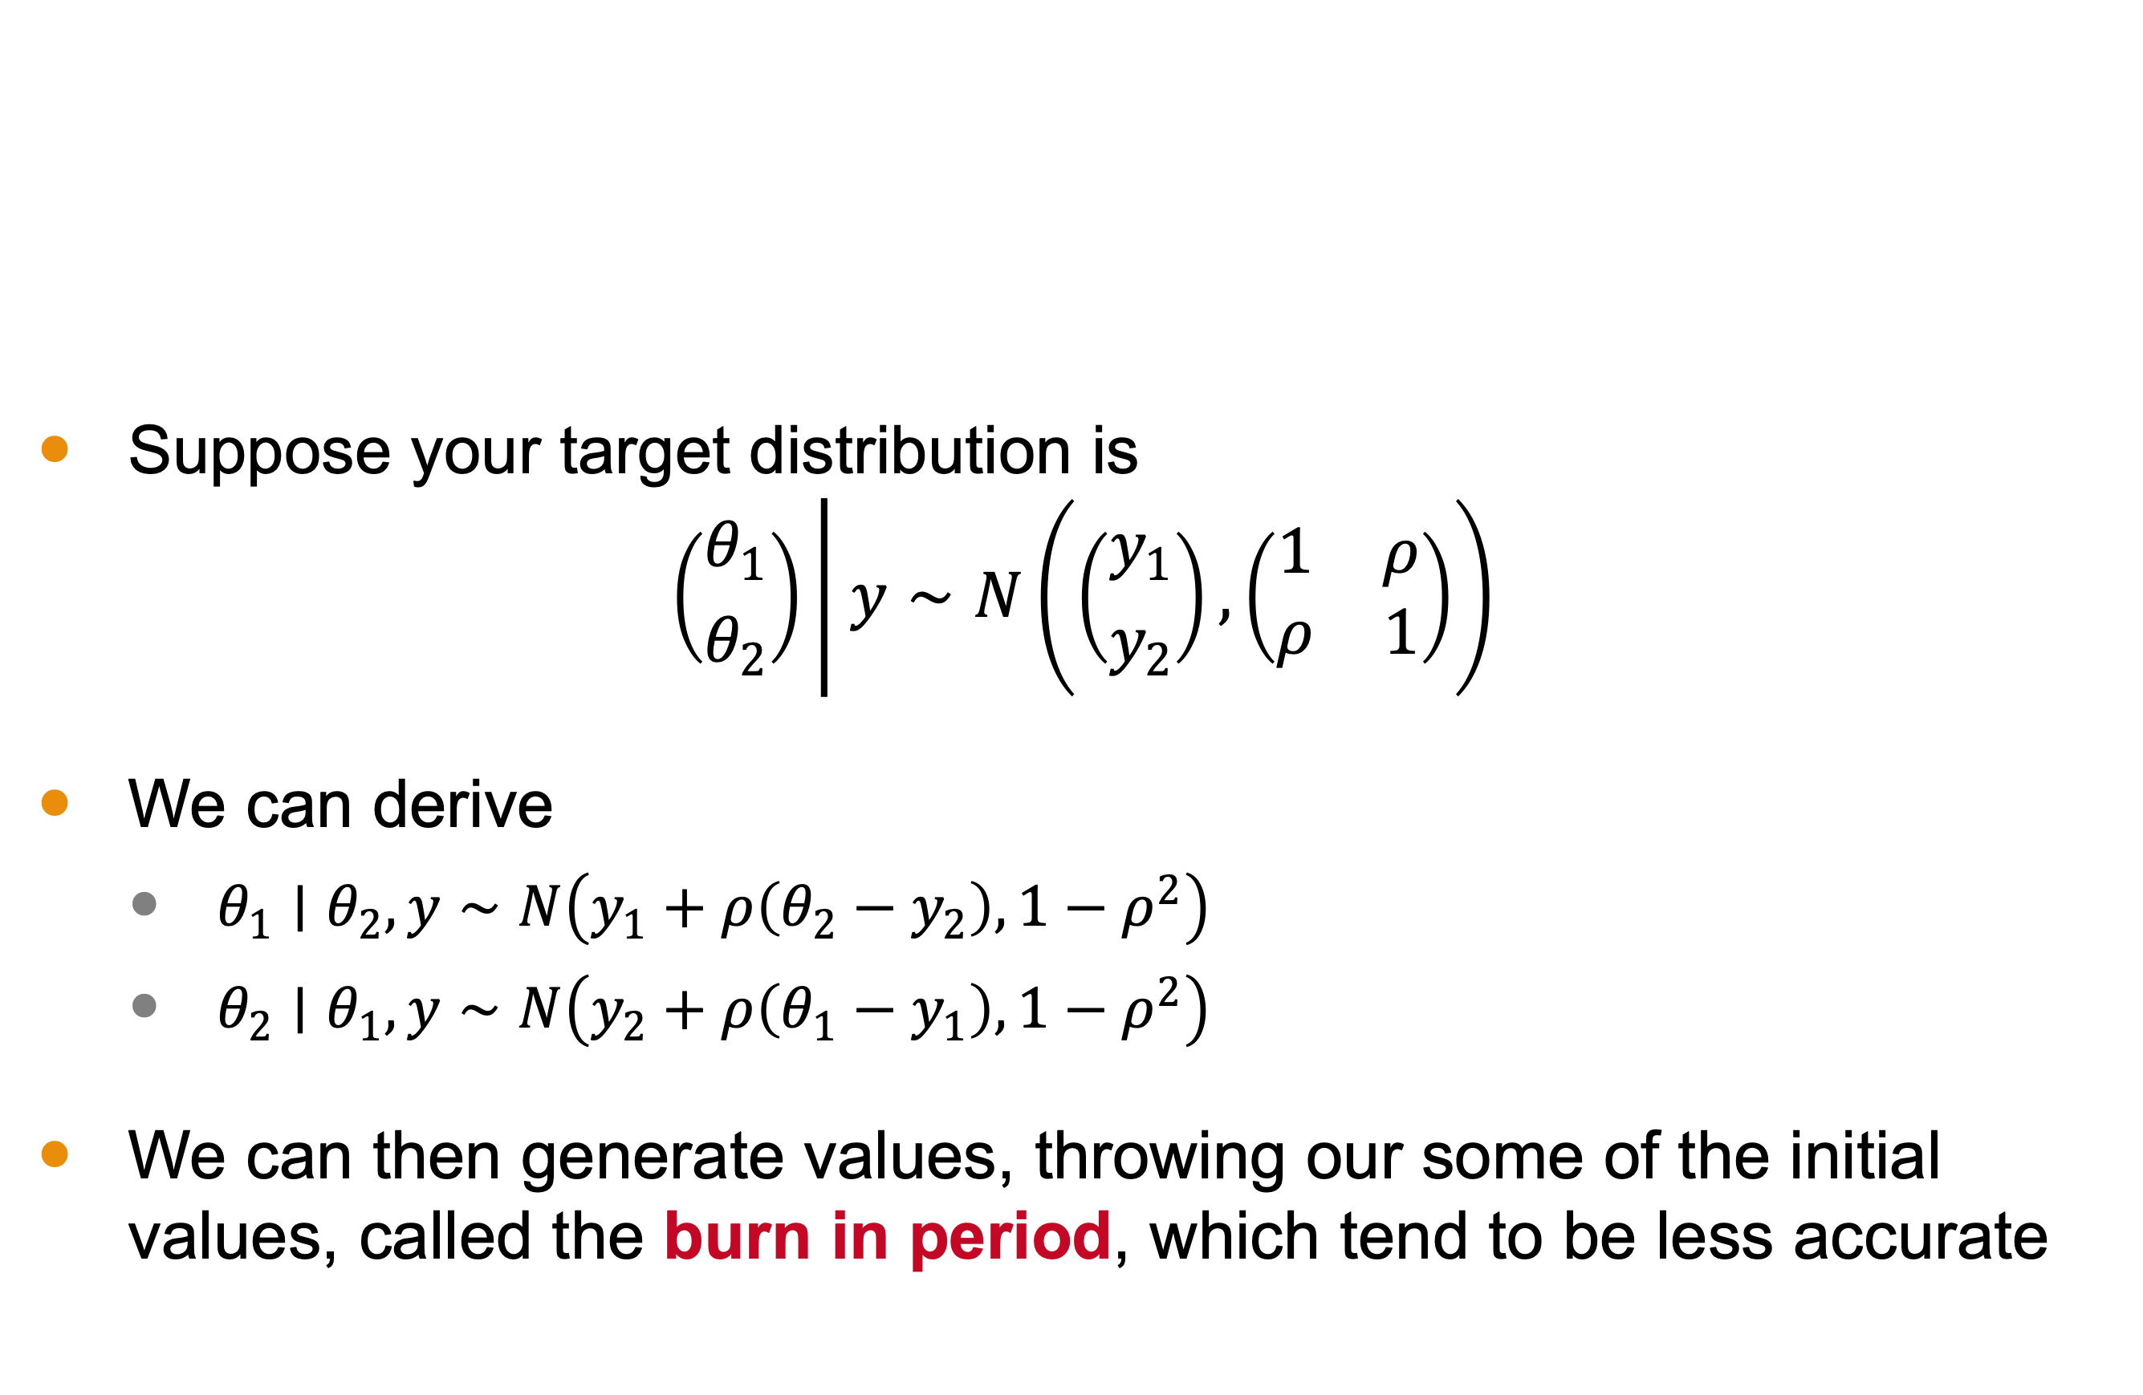
Gibbs Sampler Example
Suppose your target distribution is
$$\left({θ_{1} \atop θ_{2}}\right)\left| y∼N\left(\left({y_{1} \atop y_{2}}\right),\left(\begin{matrix}1 & ρ \\ ρ & 1\end{matrix}\right)\right)\right.$$
We can derive
$θ_{1}∣θ_{2},y∼N\left(y_{1}+ρ\left(θ_{2}−y_{2}\right),1−ρ^{2}\right)$
$θ_{2}∣θ_{1},y∼N\left(y_{2}+ρ\left(θ_{1}−y_{1}\right),1−ρ^{2}\right)$
We can then generate values, throwing our some of the initial values, called the burn in period, which tend to be less accurate

Slide 14

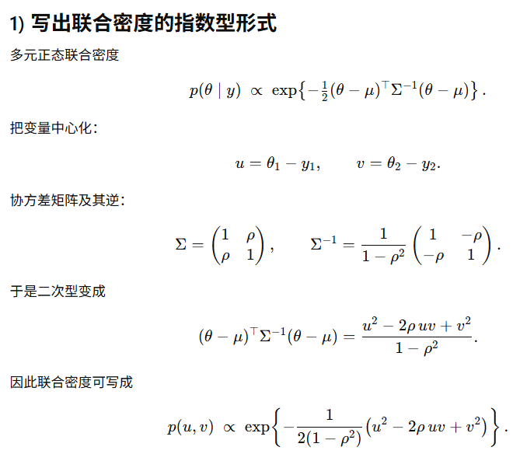
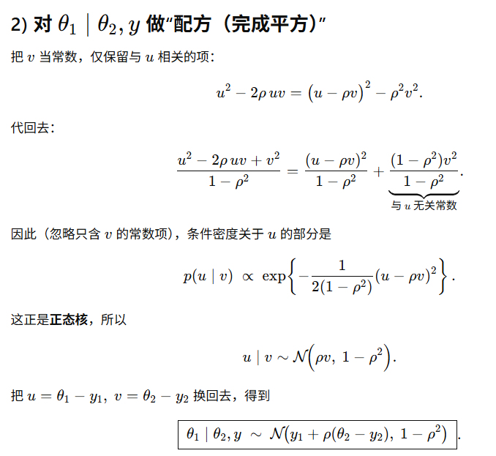
Notes:
M6L31Gibbs.mov

Slide 15
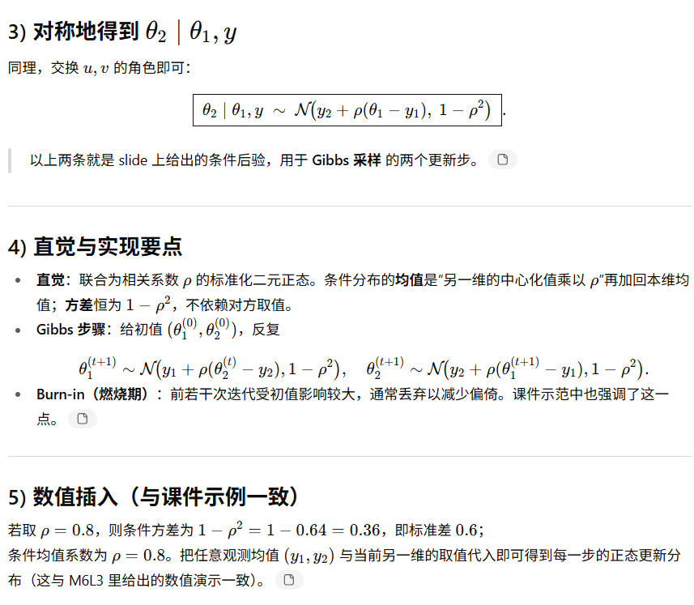
Notes:
M6L31Gibbs.mov

Slide 16
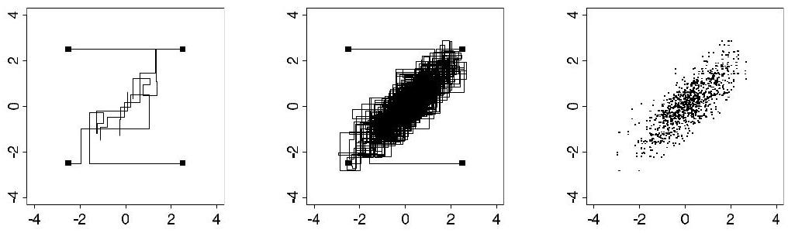
Simulations
Figure 11.2 from the textbook with four independent sequences of the Gibbs sampler for a bivariate normal distribution with correlation $ρ=0.8$

Slide 17
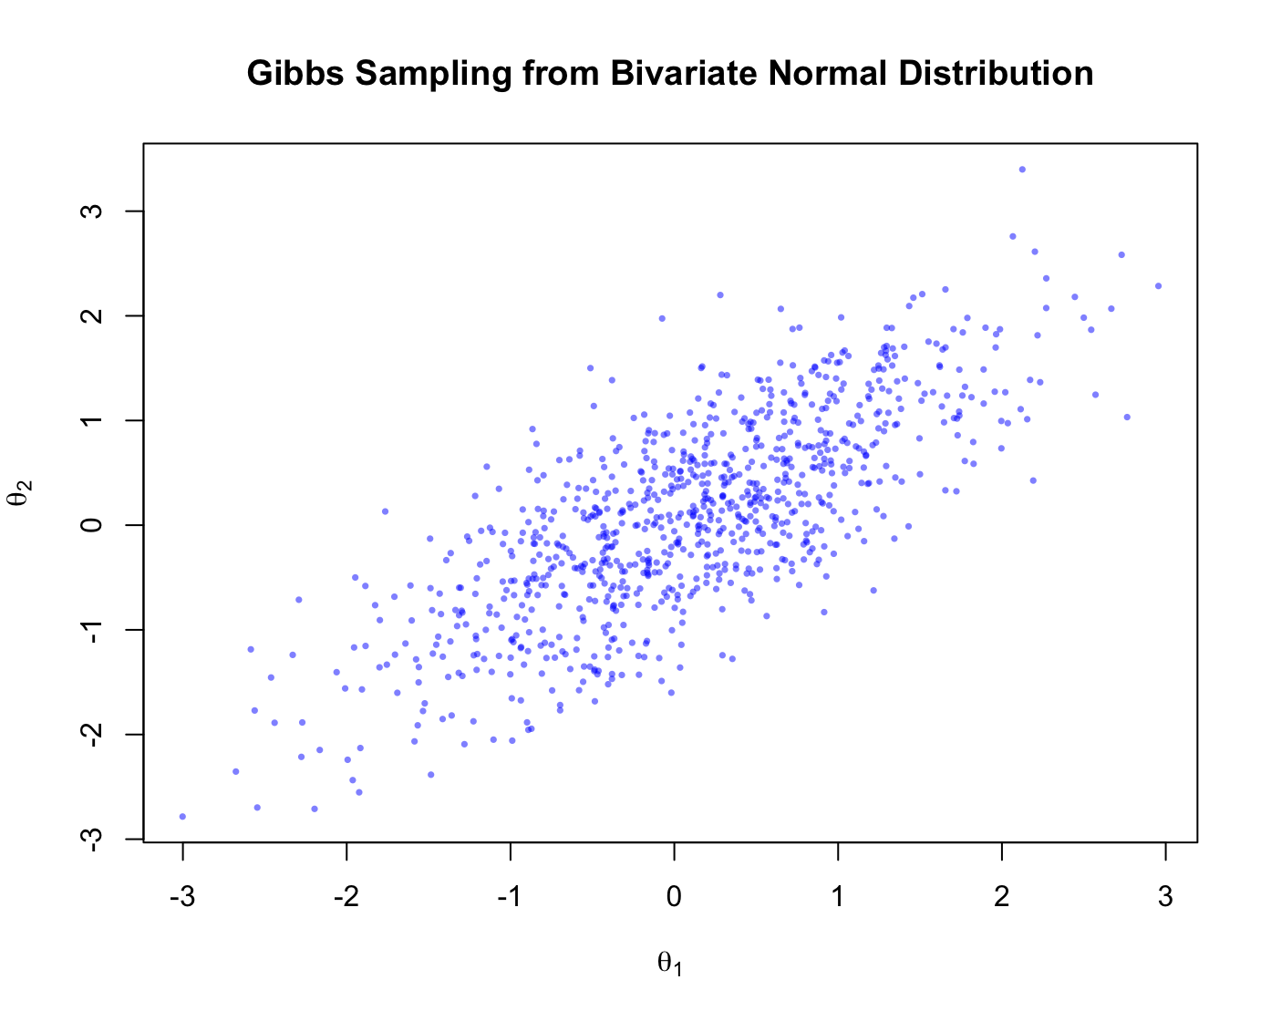
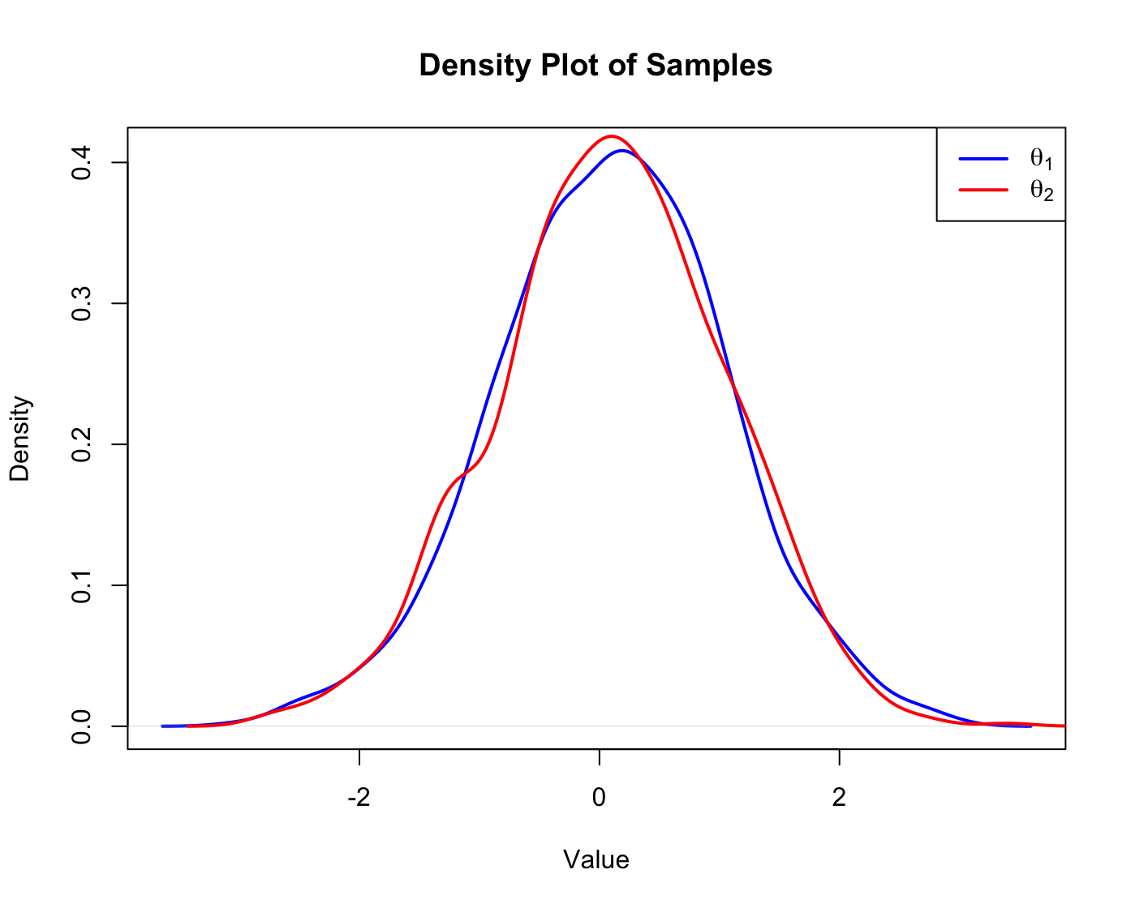
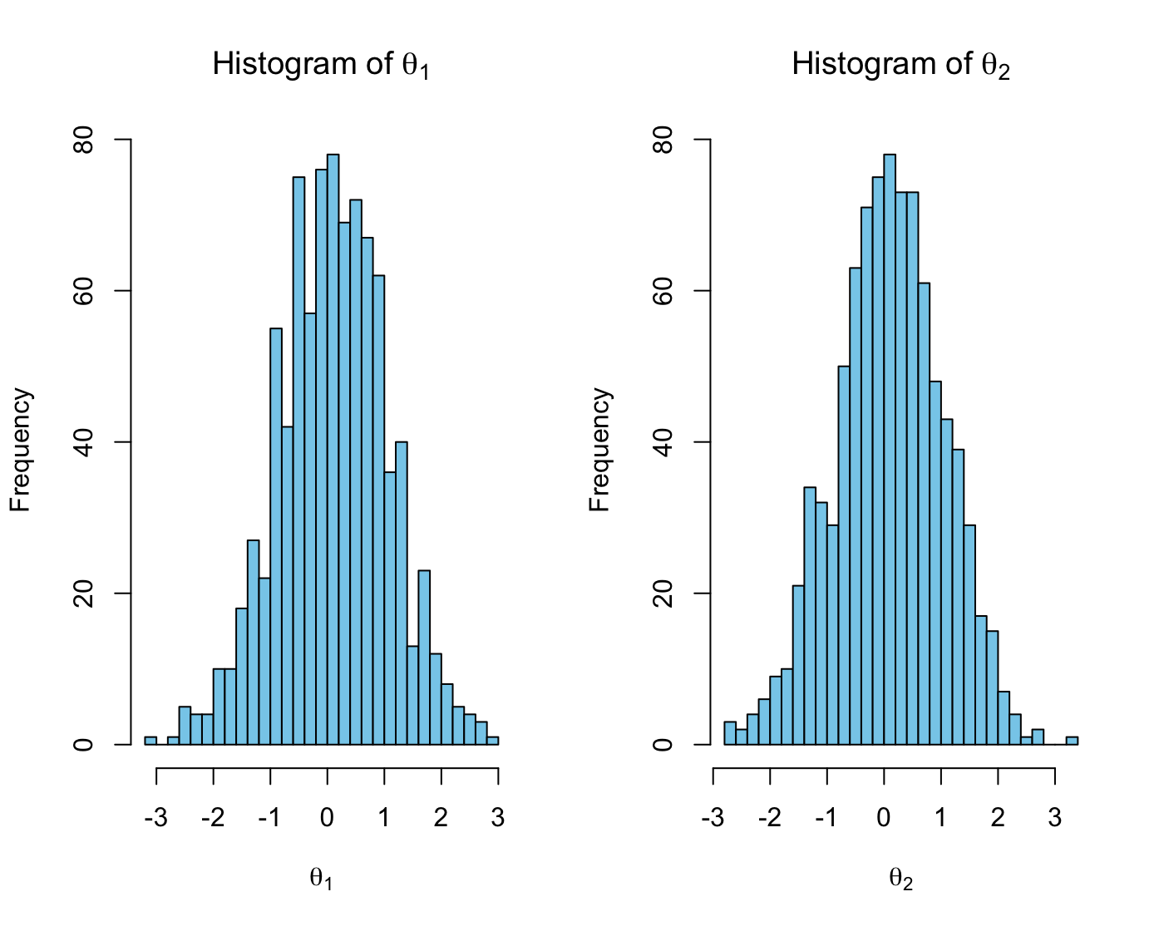
Our Simulation
We generated 1000 samples with a burn in period of 100 samples.

Slide 18
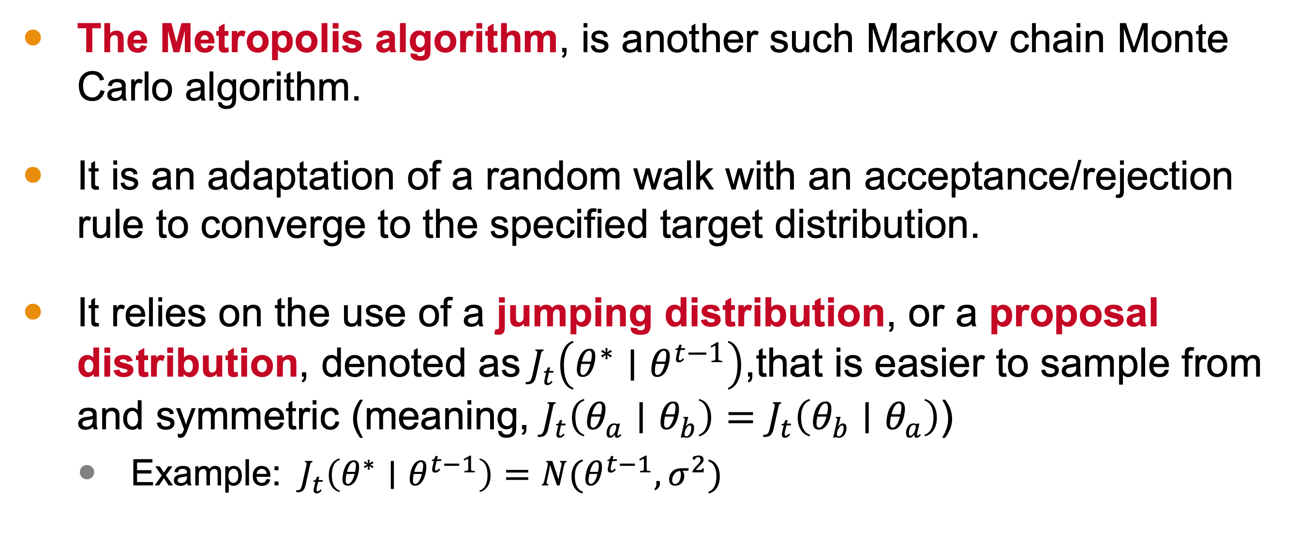
The Metropolis Algorithm
The Metropolis algorithm, is another such Markov chain Monte Carlo algorithm.
It is an adaptation of a random walk with an acceptance/rejection rule to converge to the specified target distribution.
It relies on the use of a jumping distribution, or a proposal distribution, denoted as${ J}_{t}\left(θ^{∗}∣θ^{t−1}\right)$,that is easier to sample from and symmetric (meaning, $J_{t}\left(θ_{a}∣θ_{b}\right)=J_{t}\left(θ_{b}∣θ_{a}\right)$)
Example: ${ J}_{t}\left(θ^{∗}∣θ^{t−1}\right)=N(θ^{t−1}, σ^{2})$
Notes:
The Metropolis algorithm, is another such Markov chain Monte Carlo algorithm.
It is an adaptation of a random walk with an acceptance/rejection rule to converge to the specified target distribution.
It relies on the use of a jumping distribution, or a proposal distribution, denoted as${ J}_{t}\left(θ^{∗}∣θ^{t−1}\right)$,that is easier to sample from and symmetric (meaning, $J_{t}\left(θ_{a}∣θ_{b}\right)=J_{t}\left(θ_{b}∣θ_{a}\right)$)
Example: ${ J}_{t}\left(θ^{∗}∣θ^{t−1}\right)=N(θ^{t−1}, σ^{2})$. The mean is the last known state and the variance is chosen to control for the size of jumps.

Slide 19
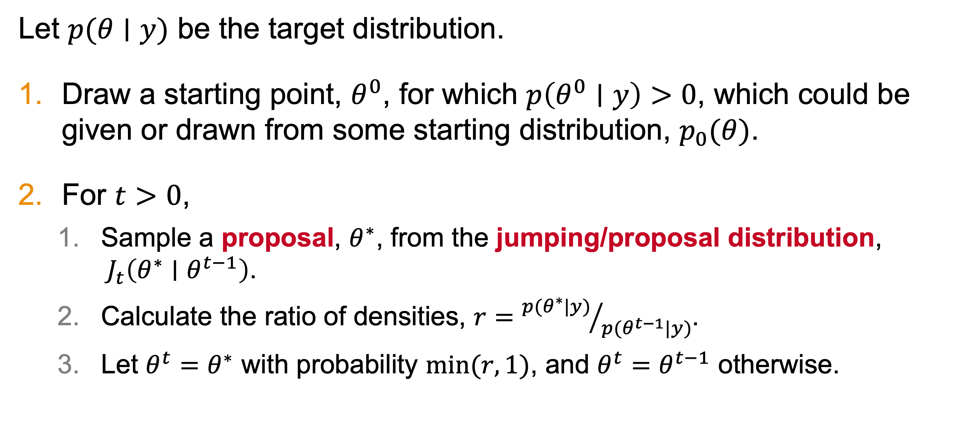
Metropolis Algorithm Steps
Let $p(θ∣y)$ be the target distribution.
Draw a starting point, $θ^{0}$, for which $p\left(θ^{0}∣y\right)>0$, which could be given or drawn from some starting distribution, $p_{0}(θ)$.
For $t>0$,
Sample a proposal, $θ^{∗}$, from the jumping/proposal distribution, ${ J}_{t}\left(θ^{∗}∣θ^{t−1}\right)$.
Calculate the ratio of densities, $r={p(θ^{∗}|y)}/{p(θ^{t−1}|y)}$.
Let $θ^{t}=$ $θ^{∗}$ with probability $min⁡(r, 1)$, and $θ^{t}=θ^{t−1}$ otherwise.

Slide 20
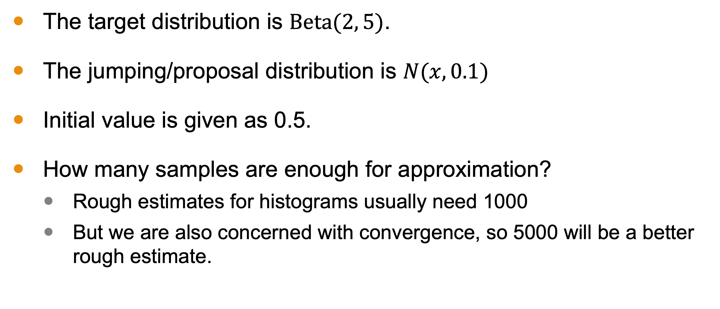
Metropolis Algorithm Example
The target distribution is $Beta(2, 5)$.
The jumping/proposal distribution is $N(x,0.1)$
Initial value is given as 0.5.
How many samples are enough for approximation?
Rough estimates for histograms usually need 1000
But we are also concerned with convergence, so 5000 will be a better rough estimate.

Slide 21
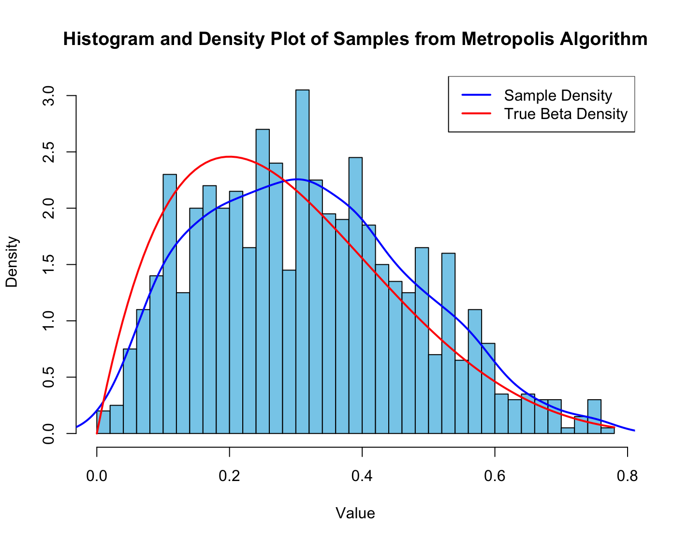
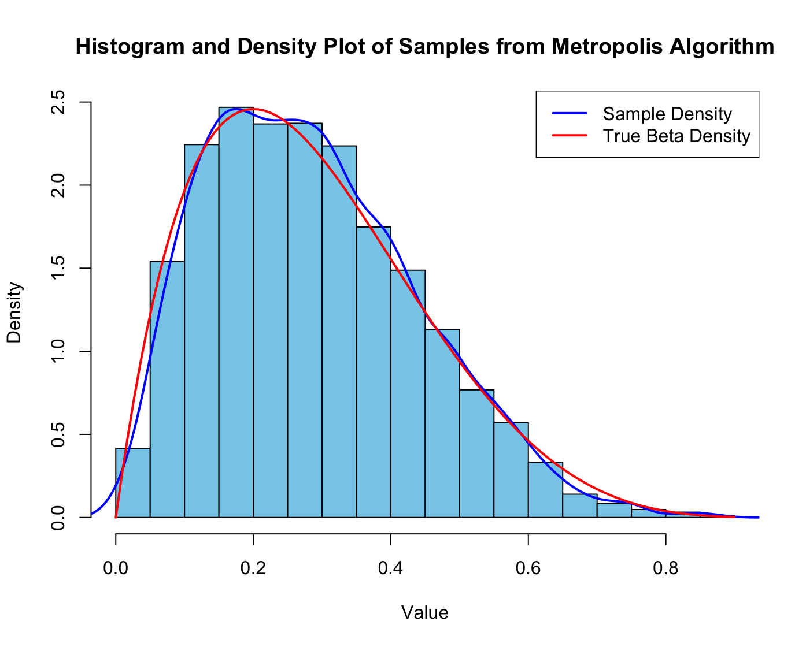
Simulations (1000 vs. 5000)

Slide 22
Picking Sample Size
The precision of an estimate generated from the Metropolis algorithm can be evaluated by computing the standard error of the estimate.
At 1,000 samples, SE = 2%
At 5,000, SE = 1%
At 13,000, SE = 0.5%
library(coda)
ess <- effectiveSize(samples)
cat("Effective Sample Size (ESS):", ess, "\n")
sample_sd <- sd(samples)
se_mean <- sample_sd / sqrt(ess)
cat("Standard Error (SE) of the Mean:", se_mean, "\n")

Slide 23
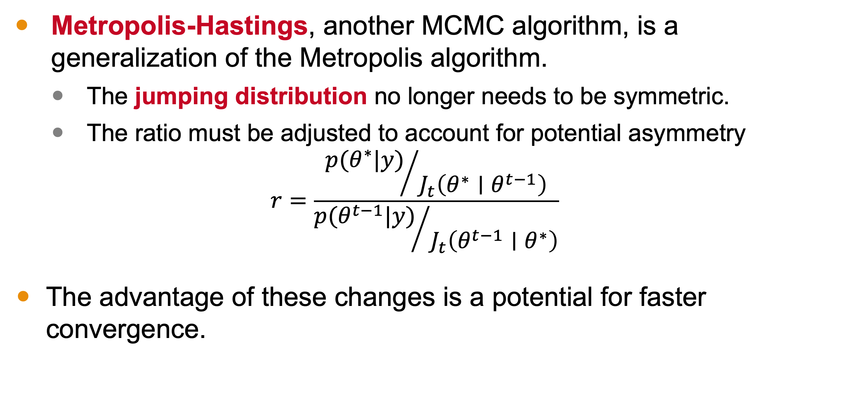
Metropolis-Hastings Algorithm
Metropolis-Hastings, another MCMC algorithm, is a generalization of the Metropolis algorithm.
The jumping distribution no longer needs to be symmetric.
The ratio must be adjusted to account for potential asymmetry
$$r=\frac{{p(θ^{∗}|y)}/{{ J}_{t}\left(θ^{∗}∣θ^{t−1}\right)}}{{p(θ^{t−1}|y)}/{{ J}_{t}\left(θ^{t−1}∣θ^{∗}\right)}}$$
The advantage of these changes is a potential for faster convergence.

Slide 24
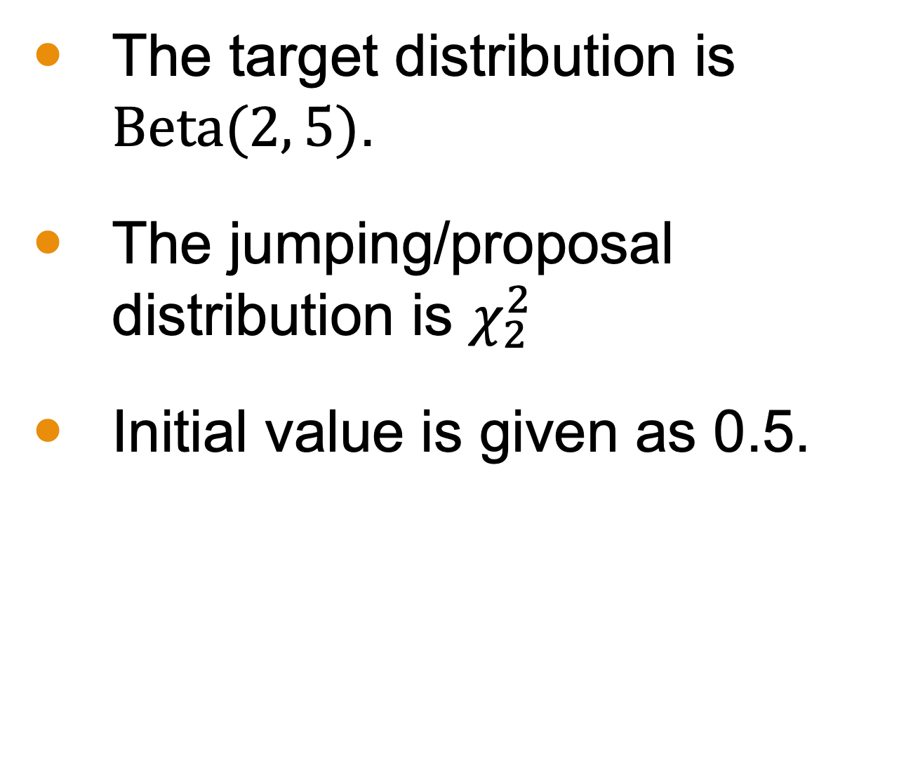
Metropolis-Hastings Algorithm Example
The target distribution is $Beta(2, 5)$.
The jumping/proposal distribution is $χ_{2}^{2}$
Initial value is given as 0.5.
Samples Collected | SE of M w/ Normal | SE of MH w/ chi-squared
1,000 | 1.9% | 1.5%
5,000 | 0.8% | 0.6%
10,000 | 0.6% | 0.4%

Slide 25
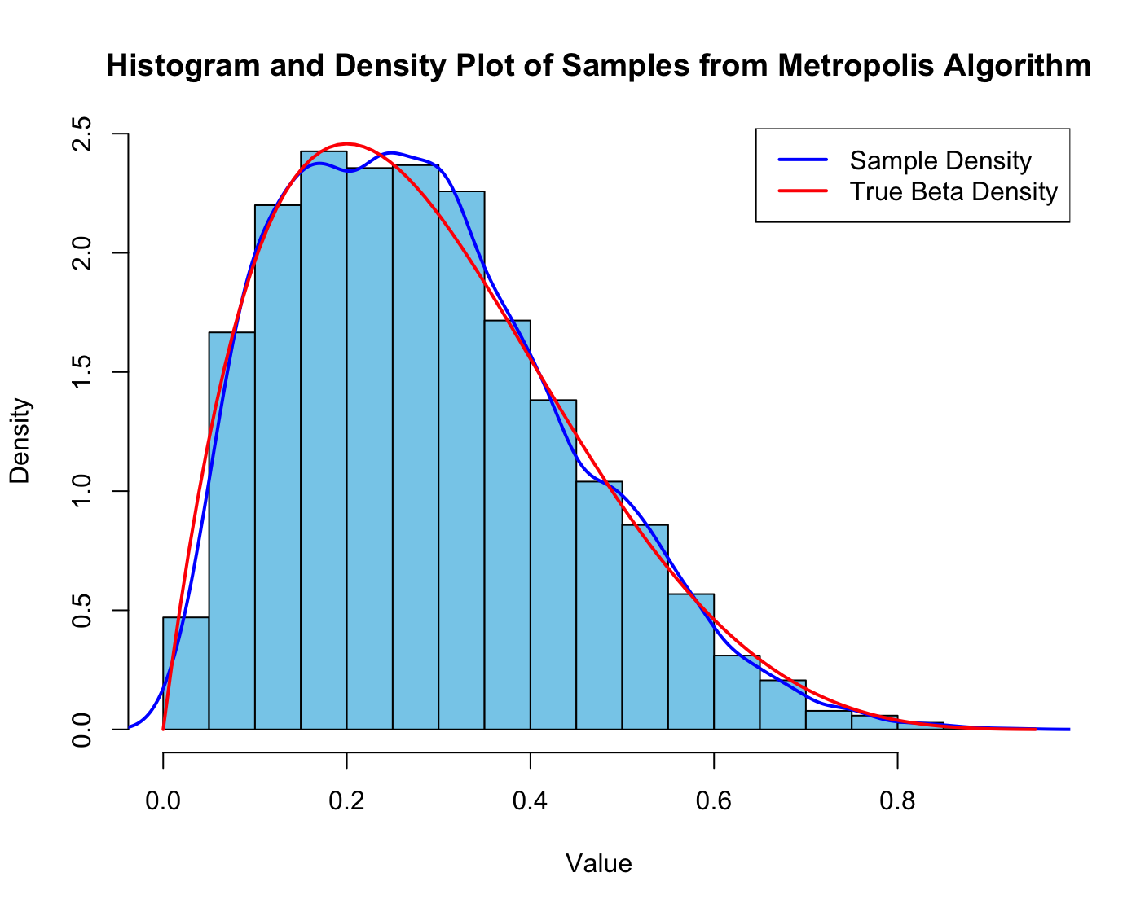
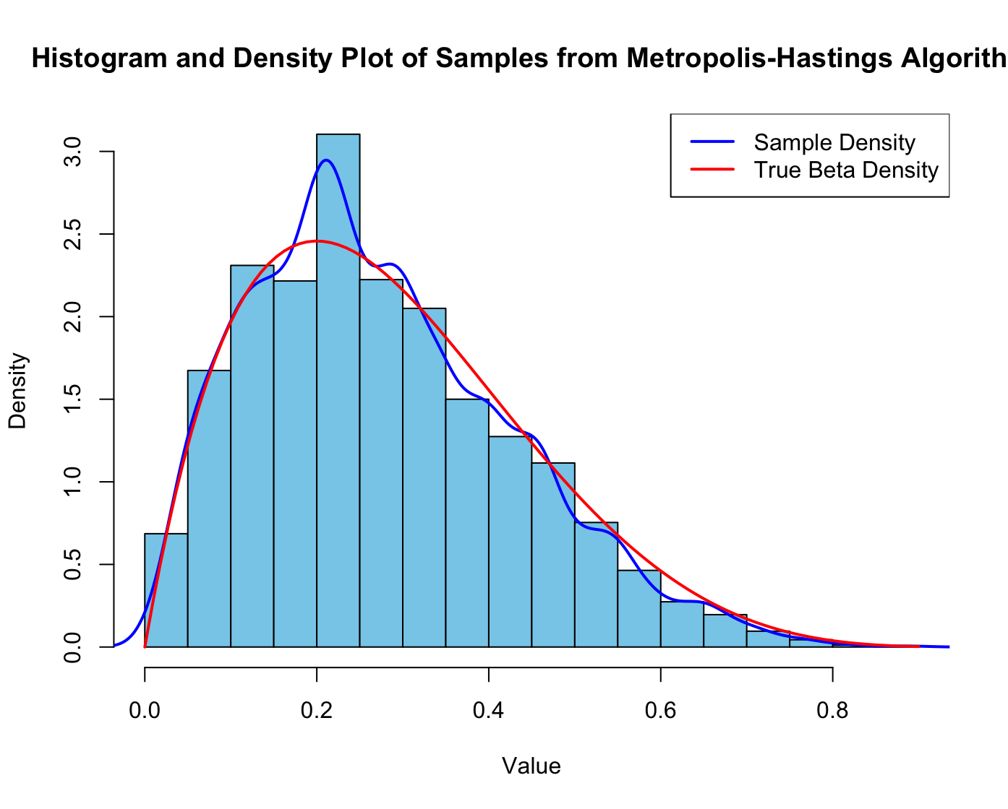
Simulations (10,000 Samples)
Jumping Distribution Choice Needs Tuning

